Slide 1
WIA1005 Network Technology Foundation
Chapter 6
IPv6

Slide 2
Contents
IPv6
ICMPv6
Subnetting

Slide 3
IPv6
On Monday, January 31, 2011, IANA allocated the last two /8 IPv4 address blocks to the Regional Internet Registries (RIRs).
The evolving Internet is becoming an Internet of things. No longer will the only devices accessing the Internet be computers, tablets and smart phones. The sensor-equipped, Internet-ready devices of tomorrow will include everything from automobiles and biomedical devices, to household appliances and natural ecosystems.
With an increasing Internet population, a limited IPv4 address space, issues with NAT and an Internet of things, the time has come to begin the transition to IPv6.

Slide 4
IPv6
IPv6 has a larger 128-bit address space. The addresses are represented using hexadecimal values.
Every 4 bits is represented by a single hexadecimal digit; for a total of 32 hexadecimal values. The preferred format for writing an IPv6 address is X:X:X:X:X:X:X:X (X=xxxx)
The first rule to help reduce the notation of IPv6 addresses is any leading 0s (zeros) in any 16-bit section or hextet can be omitted.
The second rule to help reduce the notation of IPv6 addresses is that a double colon (::) can replace any single, contiguous string of one or more 16-bit segments (hextets) consisting of all 0s.

Slide 5
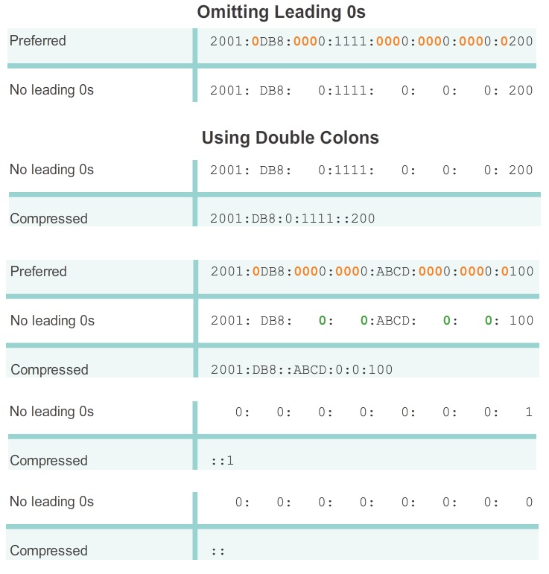

Slide 6
IPv6
There are three types of IPv6 addresses:
  Unicast - An IPv6 unicast address uniquely identifies an interface on an IPv6-enabled device.
  Multicast - An IPv6 multicast address is used to send a single IPv6 packet to multiple destinations.
  Anycast - An IPv6 anycast address is any IPv6 unicast address that can be assigned to multiple devices. A packet sent to an anycast address is routed to the nearest device having that address.

Slide 7
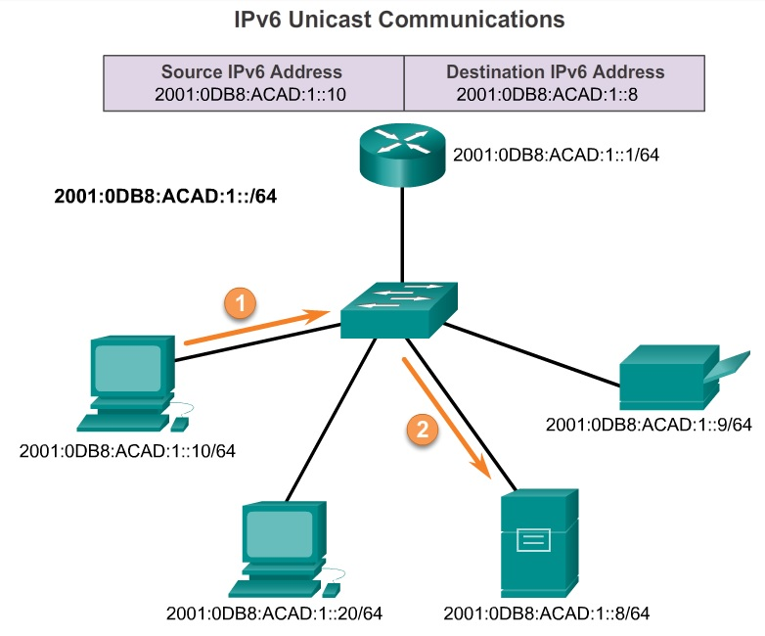
IPv6

Slide 8
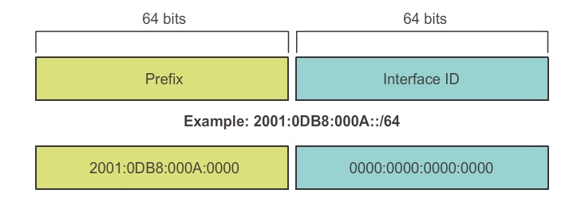
IPv6
IPv6 uses the prefix length to represent the prefix portion of the address. The prefix length is used to indicate the network portion of an IPv6 address using the IPv6 address/prefix length.

Slide 9
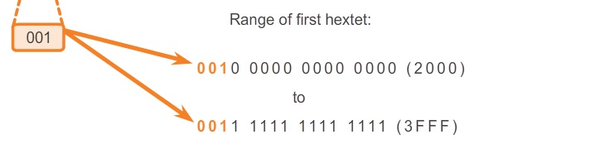
IPv6
There are six types of IPv6 unicast addresses.
Global unicast
  A global unicast address is similar to a public IPv4 address. These are globally unique, Internet routable addresses. Global unicast addresses can be configured statically or assigned dynamically.
  Currently, only global unicast addresses with the first three bits of 001 or 2000::/3 are being assigned.

Slide 10
IPv6
  Global routing prefix
    The global routing prefix is the prefix, or network, portion of the address that is assigned by the provider, such as an ISP, to a customer or site. Currently, RIRs assign a /48 global routing prefix to customers.
  Subnet ID
    The Subnet ID is used by an organization to identify subnets within its site.
  Interface ID
    The IPv6 Interface ID is equivalent to the host portion of an IPv4 address.

Slide 11
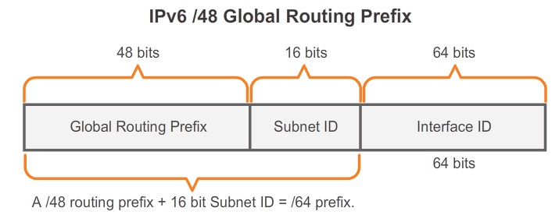
IPv6

Slide 12
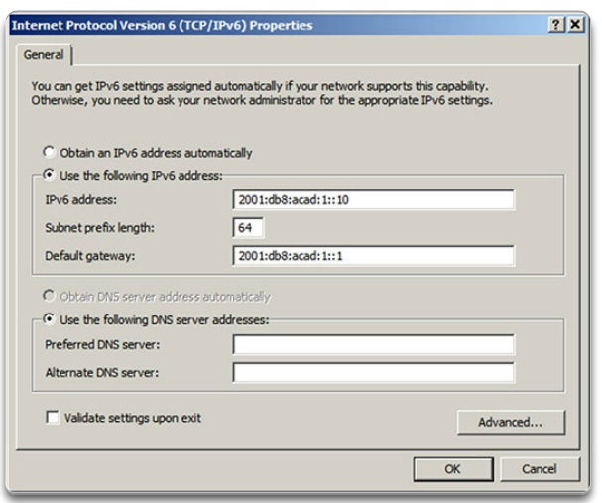
IPv6
Manually configuring the IPv6 address on a host is similar to configuring an IPv4 address.

Slide 13
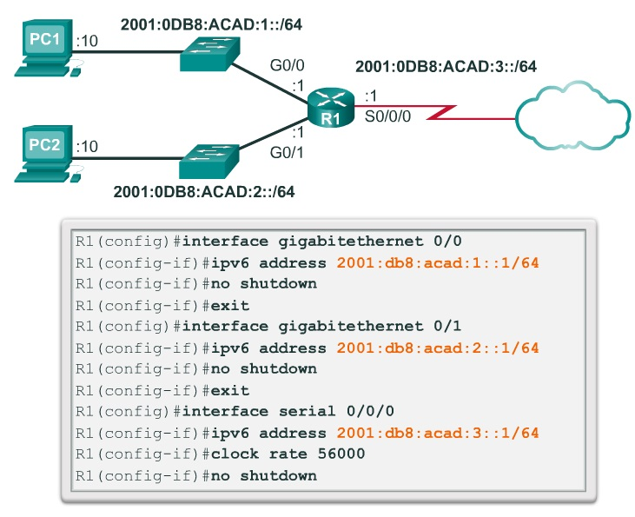
IPv6

Slide 14
IPv6
Link-local
  Link-local addresses are used to communicate with other devices on the same local link that refers to a subnet. Link-local address is unique on that link because they are not routable beyond the link. Routers will not forward packets with a link-local address.
  IPv6 link-local addresses are in the FE80::/10 range.
  A link-local address can be established dynamically or configured manually as a static link-local address. By default, Cisco IOS routers use EUI-64 to generate the Interface ID for all link-local address on IPv6 interfaces.

Slide 15
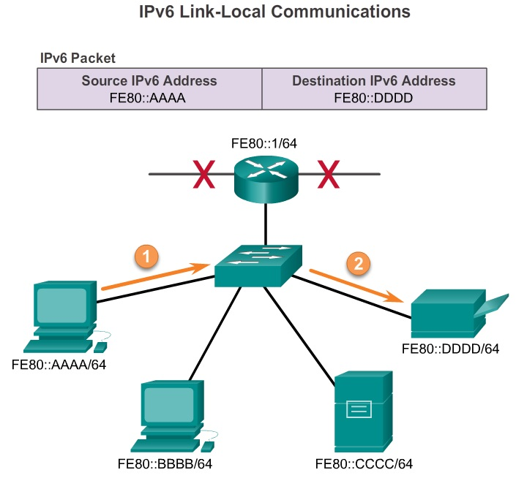
IPv6

Slide 16
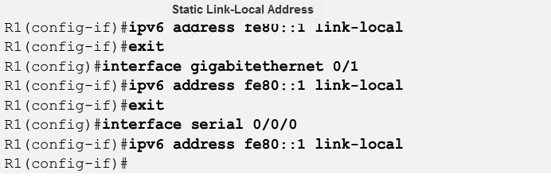
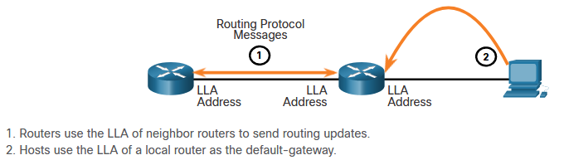
IPv6

Slide 17
IPv6
Loopback
  The loopback address ::1 is used by a host to send a packet to itself and cannot be assigned to a physical interface.
Unspecified address
  An unspecified address :: cannot be assigned to an interface and is only be used as a source address.
Unique local
  Unique local addresses are used for local addressing within a site or between a limited number of sites. These addresses should not be routable in the global IPv6. Unique local addresses are in the range of FC00::/7 to FDFF::/7.

Slide 18
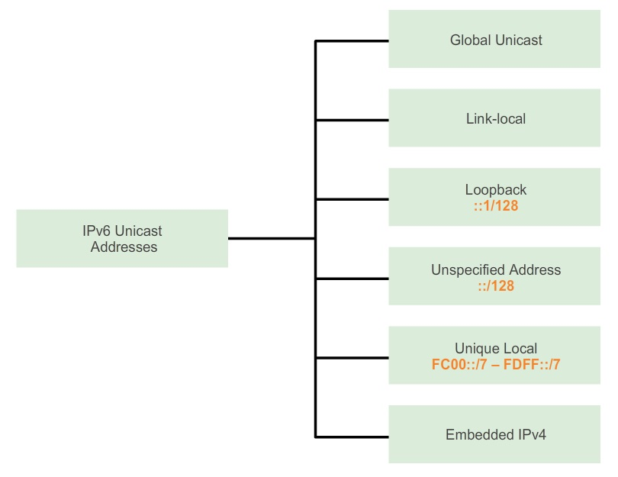
IPv6

Slide 19
IPv6
Stateless Address Auto Configuration (SLAAC)
  A method that allows a device to obtain its prefix, prefix length, and default gateway address information from an IPv6 router without the use of a DHCPv6 server.
  Using SLAAC, devices rely on the local router’s ICMPv6 Router Advertisement (RA) messages to obtain the necessary information.
  A device can send a Router Solicitation (RS) message to the router, using the IPv6 all-routers multicast group address. When an IPv6 router receives an RS message it will immediately respond with a router advertisement.

Slide 20
IPv6
Device obtains the address dynamically through Internet Control Message Protocol version 6 (ICMPv6) messages.
IPv6 routers periodically send out ICMPv6 RA messages, every 200 seconds, to all IPv6-enabled devices on the network.
An RA message will also be sent in response to a host sending an ICMPv6 RS message, which is a request for an RA message.
To enable a router as an IPv6 router, the ipv6 unicast-routing global configuration command must be used

Slide 21
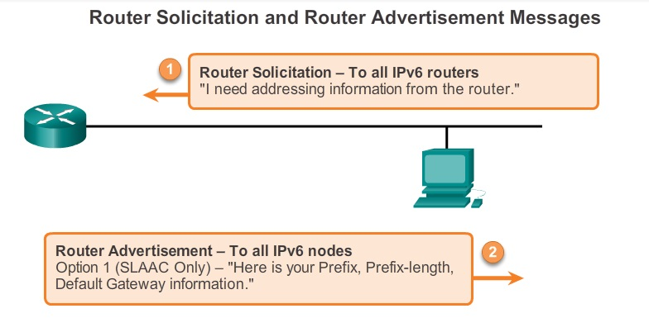
IPv6

Slide 22
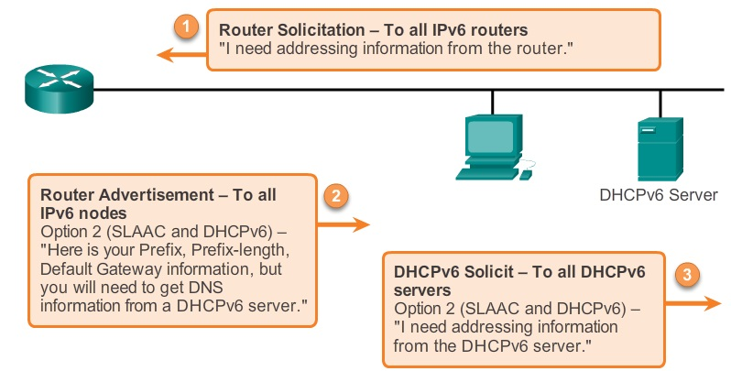
IPv6
Device can automatically receive its addressing information including a global unicast address, prefix length, default gateway address and the addresses of DNS servers using the services of a DHCPv6 server.

Slide 23
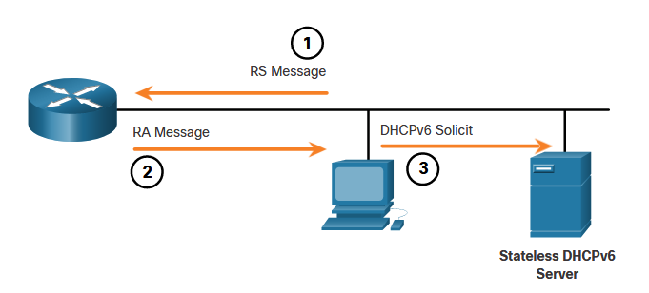
IPv6
A router interface can be configured to send a router advertisement using SLAAC and stateless DHCPv6.
A stateless DHCPv6 server provides information such as a DNS server address and a domain name.

Slide 24
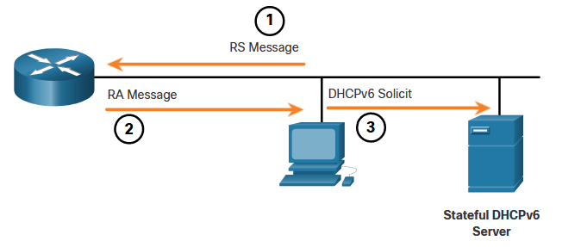
IPv6
A router interface can be configured to send an RA using stateful DHCPv6 only.
Stateful DHCPv6 is similar to DHCP for IPv4. A device can automatically receive its addressing information including a global unicast address, prefix length, and the addresses of DNS servers from a stateful DHCPv6 server.

Slide 25
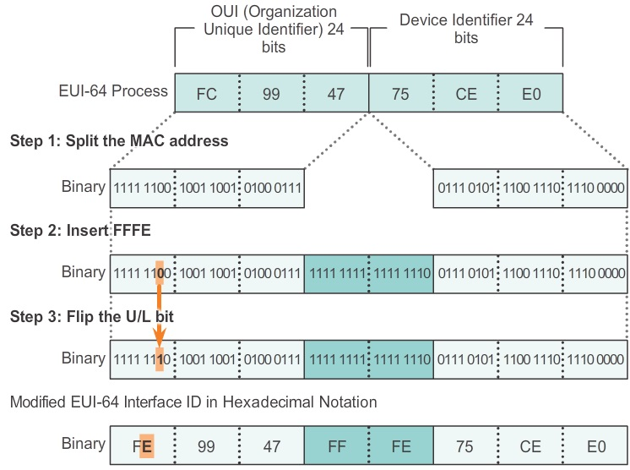
IPv6
EUI-64 Process
  This process uses a client’s 48-bit Ethernet MAC address, and inserts another 16 bits in the middle of the 48-bit MAC address to create a 64-bit Interface ID.

Slide 26
IPv6
There are two types of IPv6 multicast addresses:
Assigned Multicast
  Assigned multicast addresses are reserved multicast addresses for predefined groups of devices.
  FF02::1 All-nodes multicast group – This is a multicast group that all IPv6-enabled devices join. A packet sent to this group is received and processed by all IPv6 interfaces on the link or network.
  FF02::2 All-routers multicast group – This is a multicast group that all IPv6 routers join. A router becomes a member of this group when it is enabled as an IPv6 router with the ipv6 unicast-routing

Slide 27
IPv6
A solicited-node multicast address is an address that matches only the last 24 bits of the IPv6 global unicast address of a device. The only devices that need to process these packets are those devices that have these same 24 bits in the least significant, far right portion of their Interface ID.
An IPv6 solicited-node multicast address is automatically created when the global unicast or link-local unicast addresses are assigned. The IPv6 solicited-node multicast address is created by combining a special FF02:0:0:0:0:1:FF00::/104 prefix with the far right 24 bits of its unicast address.

Slide 28
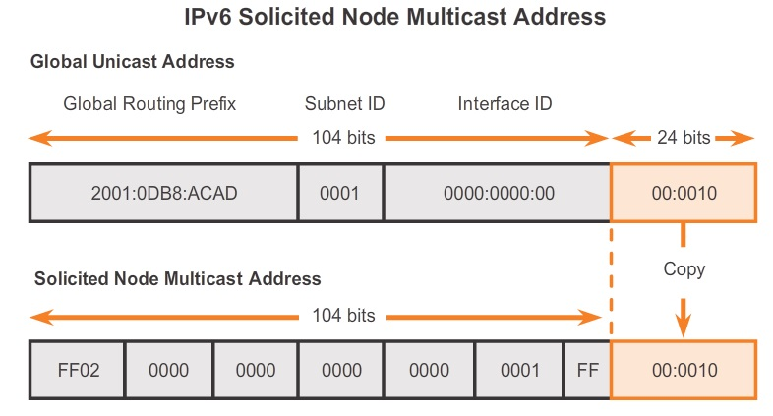
IPv6

Slide 29
IPv6
The migration from IPv4 to IPv6 can be divided into three categories:
  Dual Stack – Dual stack allows IPv4 and IPv6 to coexist on the same network. Dual stack devices run both IPv4 and IPv6 protocol stacks simultaneously.
  Tunneling – Tunneling is a method of transporting an IPv6 packet over an IPv4 network. The IPv6 packet is encapsulated inside an IPv4 packet, similar to other types of data.
  Translation – Network Address Translation 64 (NAT64) allows IPv6-enabled devices to communicate with IPv4-enabled devices using a translation technique similar to NAT for IPv4.

Slide 30
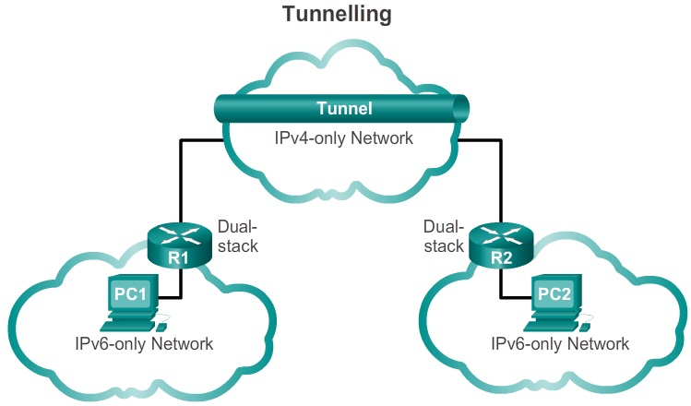
IPv6

Slide 31
ICMPv6
ICMPv6 includes five new messages as part of the Neighbor Discovery Protocol:
  Router Solicitation message
  Router Advertisement message
  Neighbor Solicitation message
  Neighbor Advertisement message
  Redirect Message
Router Solicitation (RS) message: When a host is configured to obtain its addressing information automatically using Stateless Address Auto Configuration (SLAAC), the host will send an RS message to the router.

Slide 32
ICMPv6
Router Advertisement (RA) message: RA messages are sent by routers to provide addressing information to hosts using SLAAC.
Neighbor Solicitation message and Neighbor Advertisement message are used for Address resolution and Duplicate Address Detection (DAD).
Redirect message is used for better next-hop selection

Slide 33
ICMPv6
Duplicate Address Detection
  When a device is assigned a global unicast or link-local unicast address, it is recommended DAD is performed on the address to ensure that it is unique.
  To check the uniqueness of an address, the device will send a NS message with its own IPv6 address as the targeted IPv6 address. If another device on the network has this address it will respond with a NA message. This NA message will notify the sending device that the address is in use.
  If a corresponding NA message is not returned within a certain period of time, the unicast address is unique and acceptable for use.

Slide 34
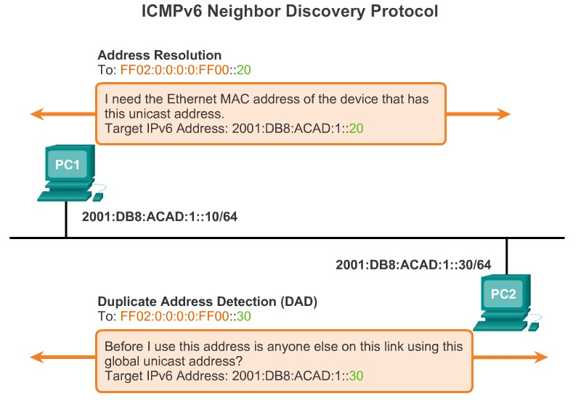
ICMPv6

Slide 35
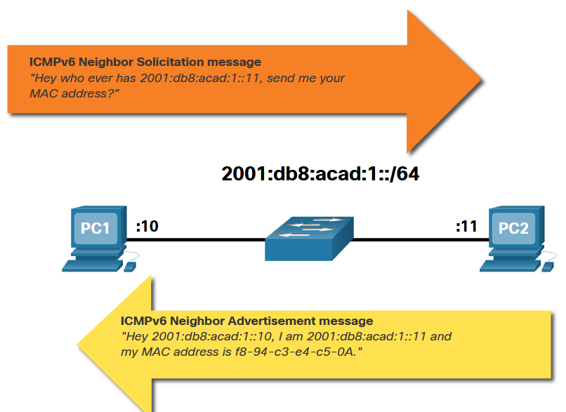
ICMPv6
Address Resolution
  Address resolution is used when a device on the LAN knows the IPv6 unicast address of a destination but does not know its Ethernet MAC address. To determine the MAC address for the destination, the device will send an NS message to the solicited node address.

Slide 36
Subnetting
IPv6 subnetting requires a different approach than IPv4 subnetting. An IPv6 address space is not subnetted to conserve addresses; rather, it is subnetted to support hierarchical, logical design of the network.
Subnetting using the 16 bit subnet ID yields a possible 65,536 /64 subnets and does not require borrowing any bits from the interface ID, or host portion of the address.

Slide 37
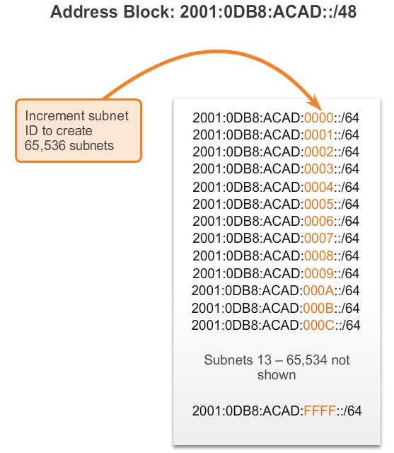
Subnetting

Slide 38
Subnetting
Similar to borrowing bits from the host portion of an IPv4 address, with IPv6 bits can be borrowed from the interface ID to create additional IPv6 subnets. This is typically done for security reasons to create fewer hosts per subnet and not necessarily to create additional subnets.
When extending the subnet ID by borrowing bits from the interface ID, the best practice is to subnet on a nibble boundary.
A nibble is 4 bits or one hexadecimal digit. The /64 subnet prefix is extended 4 bits or 1 nibble to /68. Doing this reduces the size of the interface ID by 4 bits, from 64 to 60 bits.

Slide 39
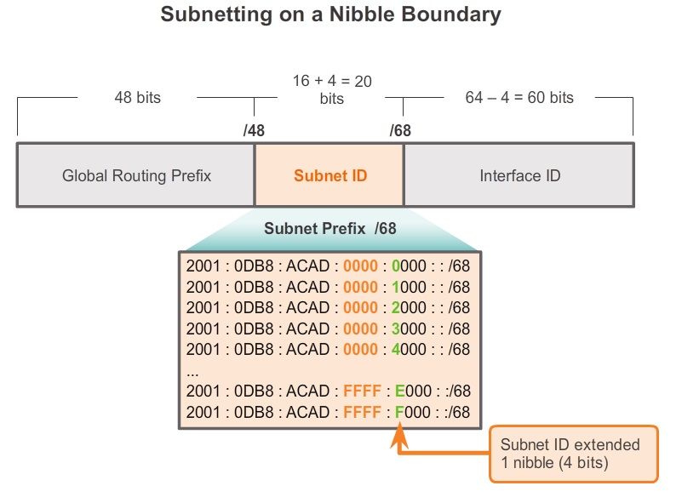
Subnetting

